Slide 1


CMR TECHNICAL CAMPUS
(Sponsored by CMR Technical Education Society, Reg.No: 1128/2007)
UGC AUTONOMOUS
Accredited by NBA& NAAC with ‘A’ Grade Approved by AICTE, New Delhi and JNTU, Hyderabad
Kandlakoya (V), Medchal Road, Hyderabad - 501 401 Ph.No: 9247033440/41;www.cmrtc.ac.in; info@cmrtc.ac.in
ESTD: 2 0 0 9
COMPUTER SCIENCE AND ENGINEERING
Regulation:R22
Subject Name: COMPILER DESIGN LAB
Topic: REGION-BASED REGISTER ALLOCATOR
Subject Code: (22CS704PC)
Presentation by-
P. Tejaswi 227R1A05A7
K.Sai Krishna 227R1A0593
K.Varun 227R1A0594

Slide 2
AGENDA
Introduction
Resource Allocation
Region-Based Allocation
System Architecture
Input IR Format
Output(Different Visualizations)
Conclusion

Slide 3
Introduction
To implement an advanced register allocator using region partitioning and graph coloring, optimizing register usage across a program’s control-flow graph.
Key Highlights:
Reads an intermediate representation (IR) file
Builds basic blocks and a CFG
Performs liveness analysis
Divides program into regions (SCCs)
Allocates registers per region using graph coloring
Visualizes interference and register pressure

Slide 4
Resource Allocation & Region allocation
Register allocation assigns program variables to a limited number of CPU registers to minimize memory access.
Challenges:
Limited number of physical registers
Variables may interfere (live at the same time)
Need to minimize spills (storing to memory)
Divide large functions into regions (groups of connected basic blocks) and perform allocation per region instead of the whole function.
Advantages:
Faster and more scalable
Allows local optimization within hot regions
Our Implementation:
Regions = Strongly Connected Components (SCCs) in the CFG
Each region has its own interference graph and coloring

Slide 5
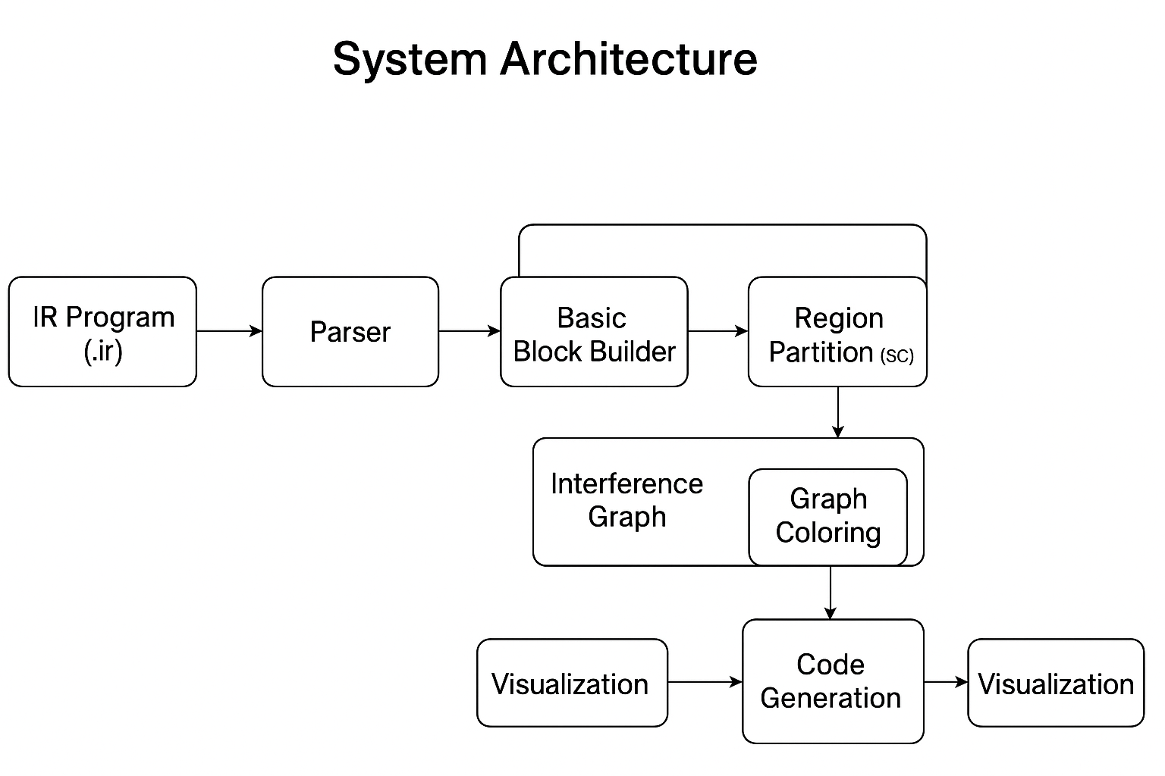
System Architecture

Slide 6
Input IR Format
start:
i = 0
sum = 0
L1:
temp = i * 1
if temp goto L2
goto L3
L2:
sum = sum + i
i = i + 1
goto L1
L3:
print sum

Slide 7
# ----- Stats & Outputs -----
print("\n=== Allocation Summary ===")
for ridx, alloc in alloc_by_region.items():
print(f"\nRegion {ridx} blocks {regions[ridx]}:")
for v, r in sorted(alloc.items()):
print(f" {v:8} -> {r or 'SPILLED'}")
print("\nGlobally spilled vars:", sorted(globally_spilled))
print("\n=== Allocated (conceptual) code ===")
for l in allocated_lines:
print(l)
# ----- Register pressure per block (live count) plot -----
pressure = [len(live_in[b]) + len(live_out[b]) for b in range(nb)]
plt.figure(figsize=(6,3))
plt.plot(range(nb), pressure, marker='o')
plt.xlabel("Block id")
plt.ylabel("approx register pressure (in+out)")
plt.title("Register pressure per block (in+out)")
plt.grid(True)
plt.tight_layout()
plt.savefig("register_pressure.png", dpi=150)
plt.close()
print("\nSaved: region_*.png and register_pressure.png")

Slide 8
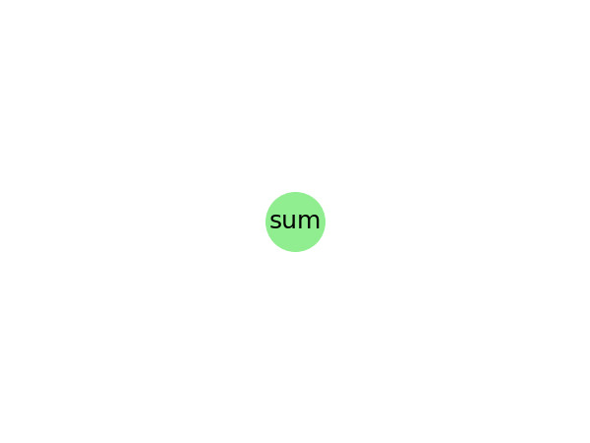

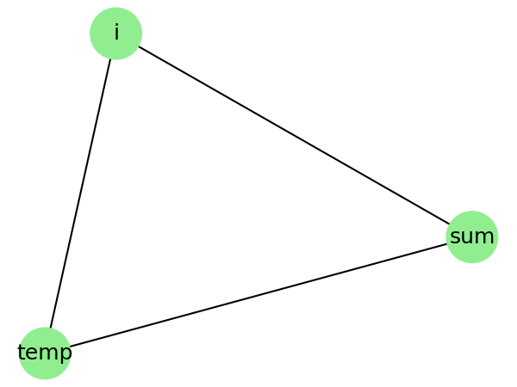
CFG, Liveness Analysis, Graph Colouring, Pressure Analysis

Slide 9
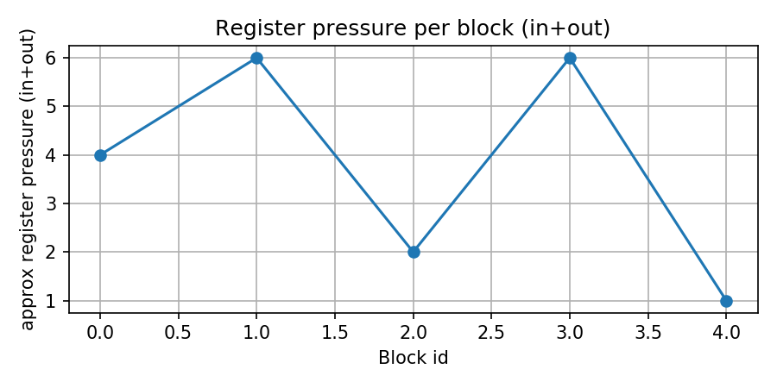
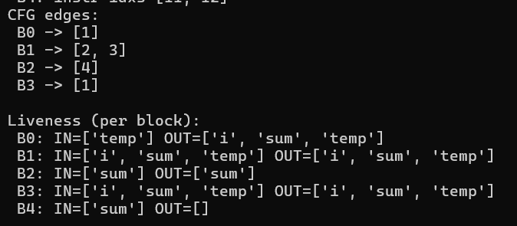

Slide 10
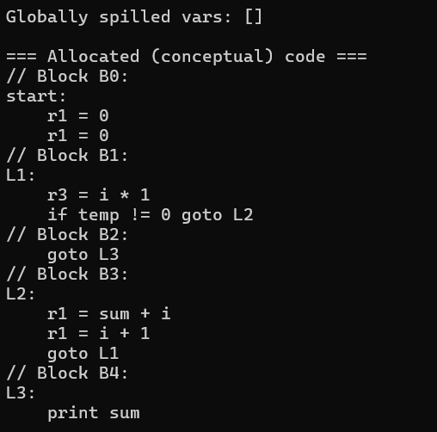
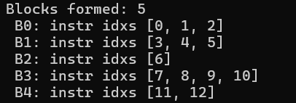

Slide 11
Conclusion
This project successfully demonstrates the design and implementation of a Region-Based Register Allocator — an advanced compiler optimization technique that efficiently assigns variables to a limited number of registers using control-flow graph (CFG) analysis, liveness computation, and graph coloring.
By dividing the program into regions (strongly connected components), the allocator performs localized optimization, reducing register conflicts and improving scalability for medium and large programs.
The integration of visualizations — including interference graphs and register pressure plots — provides valuable insight into the allocation process and program behavior.
The system effectively simulates a realistic compiler backend stage and serves as a practical example of how region-based register allocation enhances performance over traditional global allocation methods.

Slide 12
THANK YOU

